Slide 1
Computer
Adaptive Testing in
Educational Assessment
A Tech Demo By Oscar Li and Hajin Kim
Notes:
our names
we gon do tech demo

Slide 2
Background
What is Computer Adaptive Testing (CAT) and Multistage Testing (MST)?
What are the goals of our project?
Notes:
First, a little background about our project.
Computer adaptive testing, also known as CAT, is a form of test that adjusts its difficulty according to the user’s ability in order to achieve a more precise estimate of the test taker’s ability using fewer test items compared to a traditional fixed length test. Multistage testing is a form of CAT that involves administering test items in groups, also known as stages or testlets, and using the result of each testlet to inform the administration of subsequent testlets.
Our project aims to explore the feasibility of implementing a computer adaptive test at a small scale and to measure the effectiveness of multistage testing in comparison to traditional fixed length tests.

Slide 3


Multistage Testing in R
The mstR package provides implementations for commonly used algorithms.
Our test uses one-parameter logistic model (1PL)
Using released questions from TIMSS 2011 Grade 8 Mathematics Assessment
Notes:
Our project utilises mstR which is an R package that provides implementations of commonly used algorithms in multistage testing. More specifically, our test is designed using the 1 parameter logistic model (1PL) which measures test items based on a single characteristic, item difficulty. We plan to create a calibrated item bank using questions from the TIMSS 2011 Grade 8 Mathematics Assessment. After exploring the functionality provided by mstR, we identified two functions that were crucial for our application.

Slide 4
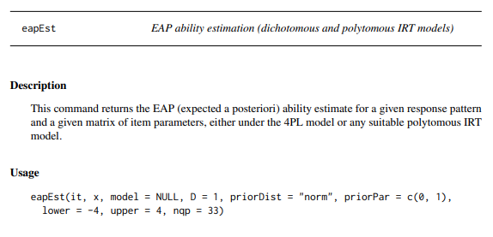
Notes:
The first of which is the eapEst() function which allows us to calculate the ability estimate of a test taker based on their responses. Using the 1 parameter logistic model, the ability estimate is determined not only by the number of questions answered correctly but also by the difficulty of the questions answered.

Slide 5
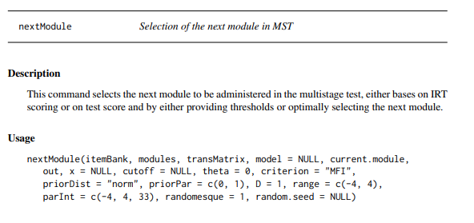
Notes:
After we have obtained the ability estimate, we can then use it to call the nextModule() function which selects the next testlet that best matches the ability of the user.

Slide 6
Test Design
High Ability Testlet
Initial Testlet
Medium Ability Testlet
Low Ability Testlet
Stage 1
Stage 2
Notes:
Using mstR, our plan is to create a two stage test with an initial testlet in the first stage which branches into three testlets in the second stage. Using this test design and the R functions discussed previously, the next challenge was to implement a functional online testing application which I will discuss now.
All users will submit their responses for the same testlet in the first stage. The application then uses these responses to generate an ability estimate and select the next stage of questions that each user should receive. Once the user has completed the second stage, the test concludes and the responses from both stages are used to calculate the final score for the user.

Slide 7




Software Architecture
Notes:
The technology we used for our project is Java for the backend using Spring Boot and MongoDB and JavaScript for the frontend using React. In order to utilise the mstR package for our project, we also utilised the RCaller Java library which allows us to call R functions from within Java.

Slide 8
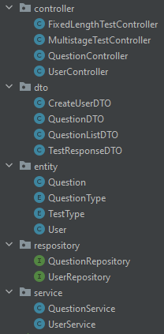
Backend Structure
API Endpoints
POST /mst Submit a testlet response
POST /fixed Submit a fixed length test response
GET /mst/:moduleId Get a testlet for a module
GET /fixed Get a fixed length test
GET /user/:userId Get a user document
Notes:
The functionality that has been implemented can be seen in the endpoints provided by the controllers. Users can sign in with their ID and sit either the traditional fixed length or the multistage tests by getting the questions from and posting their responses to the respective endpoints. Most importantly, the application calculates and stores the test scores of each user after they have submitted their responses and, in the case of the multistage test, also calculates the next module that the user should take. This information is stored in the user document and can be retrieved using the API.

Slide 9

Demo
Notes:
My name is Hajin, and I’ll be showing you a demo of our platform, which will be used for our experiment. The platform supports administration of both fixed length test and multistage test.
(On login screen)
Here’s the screen that a student would see when they first enter our platform. Before the experiment, we would have created multiple user accounts whose ID’s are distributed prior to the testing.
(Type even user id, so that you sit MST first)
(Click login, see Instruction Screen)
When you click ‘login’, it makes a request to fetch the user document associated with the given user id. This user document indicates what test a student should take, allowing frontend to fetch the relevant test set. Here, the student is to take a module of multistage test. When the user presses confirm, the frontend makes another request to fetch the questions that the student needs to take.
(click confirm, see Test screen)
Here is the test screen.
(Show left)
On the left, you have the list of questions you need to answer. This will be either the whole fixed length test or one module of the multistage testing.
(Middle screen)
When you click an answer, it gets stored into the application context. You can click questions on the left to change the question you are currently answering. The answered questions are displayed as green. The current question which you are on is indicated with border.
(Click submit test)
When you click submit test button, it submits the user responses to the backend. Backend processes these answers and computes the score, and returns the next module number if the test is multistage test.
(Instruction screen)
The frontend instructs you to sit the next module, as the test was a multistage test.
(Click Confirm)
When the confirm button is clicked, the frontend fetches the next module’s questions.
(Sit the test)
When a test is completed, the student will be asked to let the supervisor know.
That’s the end of the demo

Slide 10






Next steps...
Notes:
Moving forward, we plan to conduct pilot testing to gather feedbacks on our platform. We also aim to conduct experiment on highschool students, so that we can measure and evaluate the effectiveness of multistage computer adaptive testing.
We aim to do that by using data analysis on the scores that students achieve in a fixed length test and the scores that students achieve in multistage testing. This is possible as the responses are collected through the platform, and we will have scores for both multistage and fixed length test recorded on the user document.
That’s the end of our demo. Hope you enjoyed our tech demo. See you next time.

